Slide 1
Testing DOM mods with Q Unit

Slide 2
Team Members..!!
Akhil Kumar Reddy Busireddy
Sai Samrat Adloori
Subrahmanya Sai Bharadwaj Gandrakota
Gunashekar Koppula

Slide 3




Akhil Kumar Gunashekar Bharadwaj Samrat

Slide 4
Introduction to DOM (Document Object Model)
The application programming interface which defines the logic structure of the documents, by this it states a way how the document is accessed and manipulated ,where DOM is used to manage the data in document.
Any thing the documents can be accessed, changed, deleted, or added using the Document Object Model, with a few limitations

Slide 5
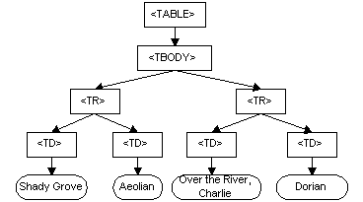
Dom Representation Sample
<TABLE>
<TBODY>
<TR>
<TD>Shady Grove</TD>
<TD>Aeolian</TD>
</TR>
<TR>
<TD>Over the River, Charlie</TD>
<TD>Dorian</TD>
</TR>
</TBODY>
</TABLE>

Slide 6
What is Unit testing.?
In the developers point of view the verification of code by the developers it self
This process of testing can be done in two ways
Manual testing
Automated testing

Slide 7
Manual Testing : For every use case developers will test their code by giving respective inputs to ensure that the piece of code meets the requirement.
Automated testing : With the help of some external tool or frame work the code will be tested with minimal human interaction for all the use cases of requirement.

Slide 8
Q Unit Framework:
In the generic JavaScript code base projects which are test-driven development these kind of code bases are tested with q unit frame work in a easy way
There are two ways of setting of Q Unit
Local Installation
npm install -g qunit
easyinstall qunit
CDN Based Version

Slide 9
CDN Based Version
CDN Based Version we will include the Q Unit library into our code directly from Content Delivery Network(CDN)
In order to integrate the CDN based version we have to include the qunit url in the scprit tag in head section

Slide 10
Continuation..
<script src="https://code.jquery.com/qunit/qunit-2.9.1.js"></script>
To check the validation we write the testing code in the script in another script tag in head section itself
Some of the validations are
assert.equal
assert.notequal
Assert.ok

Slide 11
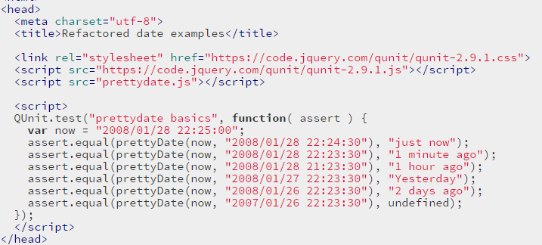
Sample Code:

Slide 12
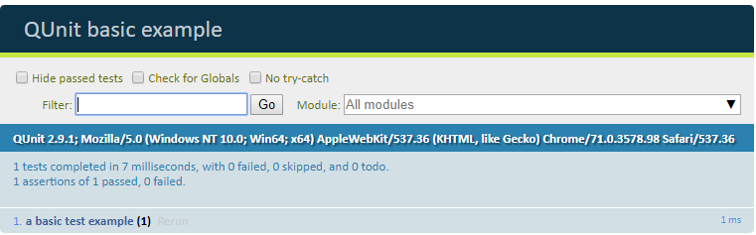
After Running

Slide 13
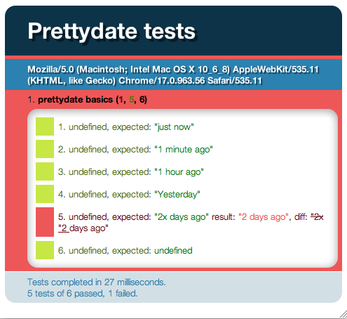
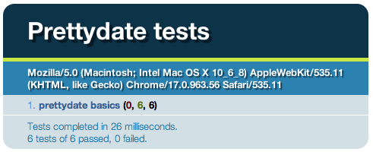
Q Unit screens
Failure scenario Success scenario

Slide 14
Any Queries?

Slide 15
Thankyou.!

